Slide 1
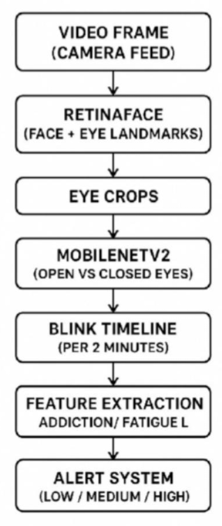
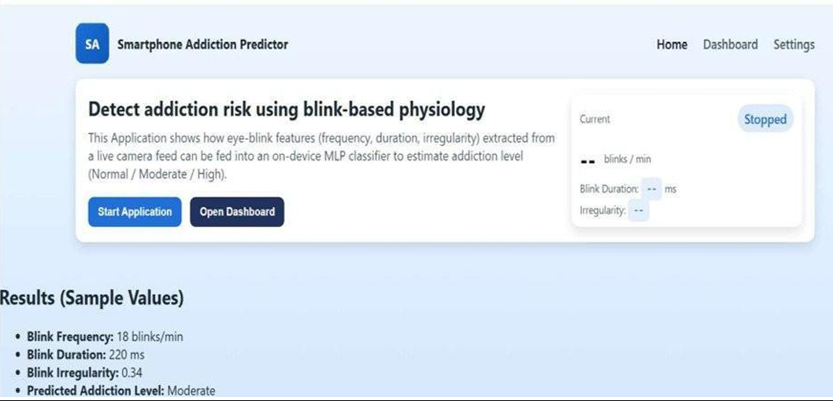
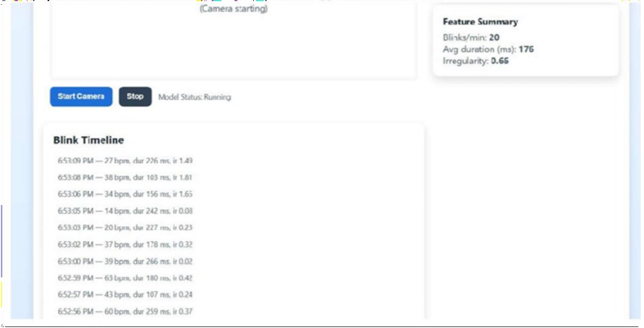
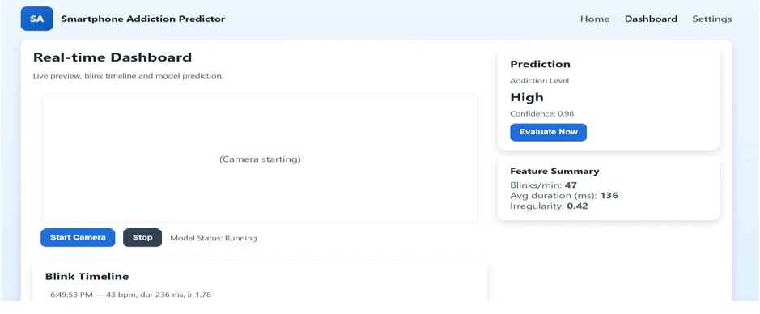
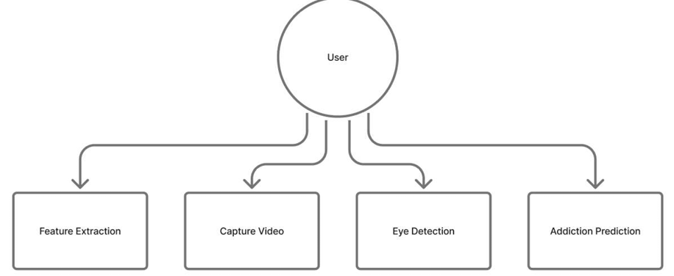
Predicting Smartphone Addiction Through DeepLearning
K.Manush-2203A51081 , M.Vedasree-2203A51371 , A.Nithin Chandra-2203A51701 , B.Shiva Sahithi-2203A51718 , G.Raviteja-2203A51721
SR University, Hasanparthy, Hanmkonda, Telangana, India
ABSTRACT
FLOWCHART OF THE SYSTEM
RESULTS
CONCLUSION
This project anticipates addiction to smartphones, it involves deep learning, which analyses the eye activity in real time rather than using screen-time statistics alone. The system observes more indicators of overuse behaviour and cognition through studying the frequency of blinking, duration of blinking, variability of blinking, classification of eye-state, and patterns of user-session, amongst others. The pipeline identifies eye features using live camera feeds supported by models such as RetinaFace and MobileNetV2 and feeds them to an MLP model to determine the level of addiction-risk in the user.
The processes involved in methodology are data preprocessing, eye-region cropping, normalisation, feature engineering, and model training and evaluation. Comparison between classification and regression techniques is made to identify the best risk-prediction method. On the whole, the system offers personalised feedback to encourage more healthy screen behavior and is part of the digital-wellness analytics, relying on AI to predict smartphone addiction and encourage healthier technology usage.
The system that has been developed predicts fatigue caused by smartphones using a deep learning pipeline on blink behavior data that eye activity is an effective digital overuse indicator. The system operates a real-time system by taking live frame feeds and executing RetinaFace to detect eye landmarks, MobileNetV2 to recognize eye-state, and an MLP to predict fatigue to identify closed or open eyes and the blink patterns.
Based on these patterns, the rate of blink, the length of blink, and variability are obtained and utilized to identify the levels of fatigue with a great level of accuracy. The system is 95% accurate in eye-state classification and 93% accurate in predicting fatigue, indicating that it can be used in digital wellness, preventing eye-strain, productivity, and even detecting smartphone addiction.
HOME PAGE
REFERENCES
The Smartphone Addiction Predictor, the Home Page offers the general information about the system and enables users to begin with the real-time analysis based on the blink.
OBJECTIVES
[1]. J. Youwei, Real-time Eye Blink Detection using General Cameras: a Facial Landmarks Approach, Int. Sci. J. of Engineering Agriculture, vol. 2, no. 5, pp. 1-8, 2023. isg-journal.com.
[2] V. Pothuraju, Raghavendra S, SantoshKumar Jankatti, and Rekha V, “Eye Blink Detection using CNN to Detect Drowsiness Level in Drivers for Road Safety,” Indonesian Journal of Electrical Engineering and Computer Science, vol. 22, no. 1, pp. 222-231, 2024. ijeecs.iaescore.com.
[3] “Eye Fatigue Estimation using Blink Detection Based on Eye Aspect Ratio Mapping (EARM),” Cognitive Robotics, vol. 2, 2022, pp. 50-59. ScienceDirect.
[4] D. Kraft, F. Hartmann, G. Bieber, et al., “Camera-based Blink Detection using 3D- Landmarks,” in Proc. iWOAR ’22: 7th International Workshop on Sensor-based Activity Recognition and AI, Rostock, Germany, Sept. 2022. ACM Digital Library .
[5] A. Jiman, A. Abdullateef, A. Almelawi, K. Yunus, Y. Kadah, A. Turki, M. Abdulaal, N. Sobahi, and Eyad Attar, “Intelligent standalone eye blinking monitoring system for computer users,” Journal of Eye Movement Research, vol. 17, no. 5, 2024. bop.unibe.ch .
The most important objective of the project is to create AI-based application, which will be able to predict the addiction to the smartphone, basing on the real time eye pattern and deep learning.
The major objectives are:
Development of a video processing pipeline, which records the eye movement of the camera feed in real time.
Eye-state recognition and localization on RetinaFace and mobile net V2 models.
The frequency, duration and variability of the behavioural characteristics of the blink were used to carry out the pull out with an aim of carrying out the addiction analysis.
Frame cropping of the eyes, normalization and feature engineering. Multilayer Perceptron (MLP) model Coding and development to predict addiction risk.
Comparison of different methods in machine learning as well as the desire to know which of them would be the most appropriate in terms of prediction accuracy.
The availability of either a personalized feedback and recommendation to the users based on the perceived risk of becoming addicted.
Rapid, accurate and on time analysis, which can be applied in day-to-day basis.
Step 1: VIDEO FRAME (CAMERA FEED)
This system starts with a live video that has been taken using a web camera or a smart phone camera. Such frames are the visual real time input of the eyes of the user which is further analyzed.
Step 2: RETINAFACE (FACE + EYE LANDMARKS) RetinaFace recognizes the face of a user and it manages to find the dots of the eye per frame. This enables the system to identify and isolate the parts of the eyes.
Step 3: EYE CROPS
The system simply crops the area of the eye which is identified. These are cut-out images that chop off the background noise and space required to perform analysis on blinking images.
Step 4: MOBILENETV2(OPEN vs Closed Eyes)
The mobile net V2 model is used to feed all the eye crops and determine whether the eye is open or closed. It triggers the series of eye states in real time that are frame by frame.
Step 5: BLINK TIMELINE (PER 2 MINUTES)
The eye-state results are also tabulated in two minutes timeline to monitor the trend of the blink like frequency of blink, duration of the blink, and irregularity. This is the chronology, the behavioural basis of addiction.
Step 6: 2D EXTRACTION OF FEATURES (ADDICTION / FATIGUE LEVEL)
The system computes such features as blink rate, variability, and eye-closures time according to the blink timeline. These indicators allow determining the degree of burnout or overuse of the smartphone by the user.
Step 7: ALERT SYSTEM (LOW / MEDIUM / HIGH)
.
BLINK TIME
The Blink Timeline section shows a live log of blink data recorded as the camera is operating and this includes the frequency of blink (bpm), the length of the blink, and the irregularity of the blink.
ACKNOWLEDGEMENTS
We express our gratitude to our mentor Mr.S.Naresh Kumar sir, Assistant Professor,SR University for providing valuable insights and guidance to our project and also all the other people who have given their opinions about the project.
PREDICTING LEVEL HIGH

